Slide 1
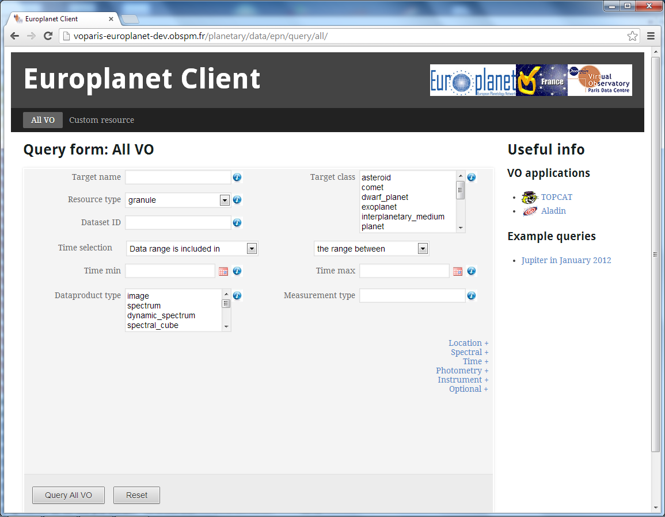
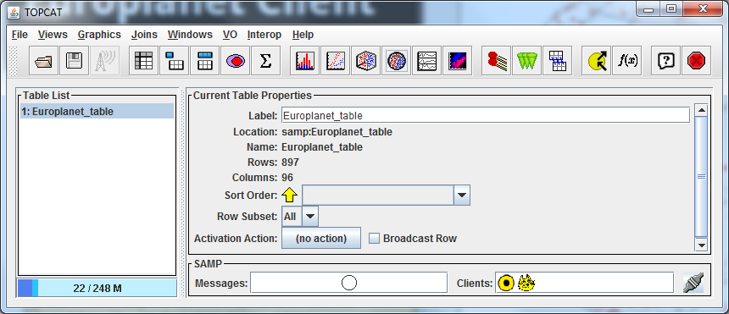
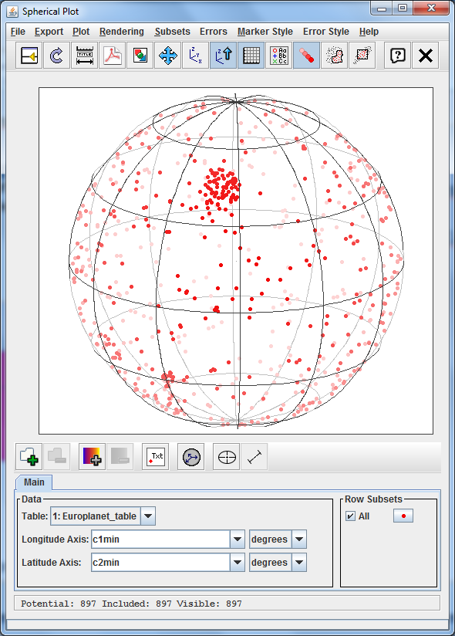
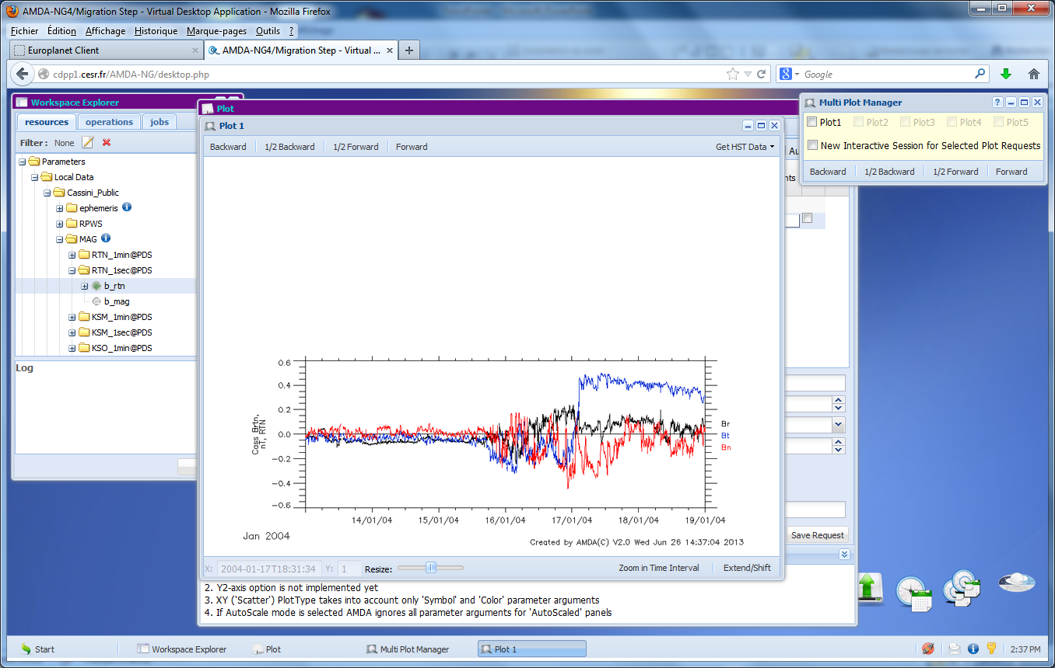
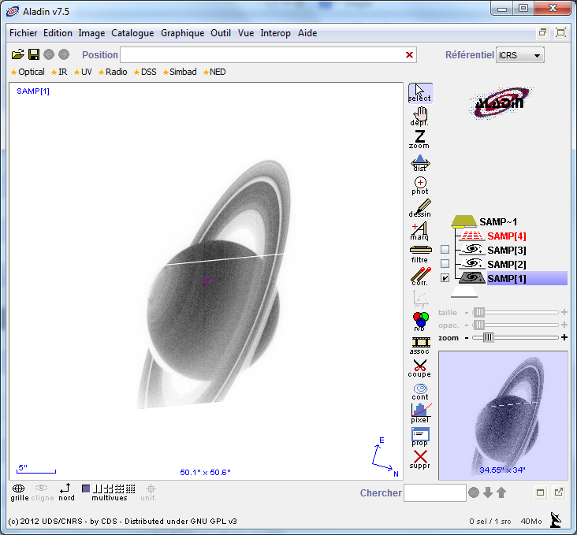
Operating principle of the Planetary Virtual Observatory
Target (class, name)
Data type
Measurment type
Time selection
…
Sends a query
Registry/Catalog
1
Data services description
Data services access
mechanisms
2
A user from the VO web page:
http://voparis-europlanet-new.obspm.fr/
Answers
Data services or databases
matching the query list
Data services access
mechanisms
5
Analysing tools
Sends data to SAMP Hub
Sends query to selected data services
Data preview and selection
Data processing
3
Answer
URL to data matching the
query
Data access mechanisms
4
Data accessible
Data services/Databases
Data services (AMDA, PSA, GhoSST, HELIO…) and small databases:
Support EPN-TAP protocol
Contain detailed description of their contents
TOPCAT, Aladin, Specview, AMDA Tools, 3DView…

