Slide 1
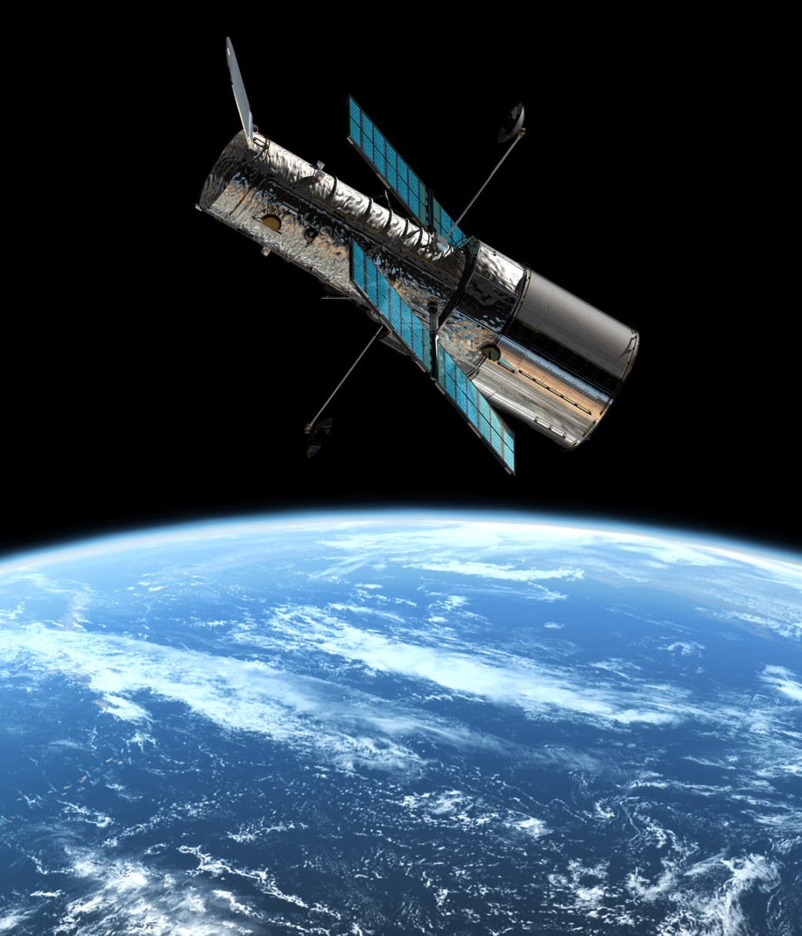
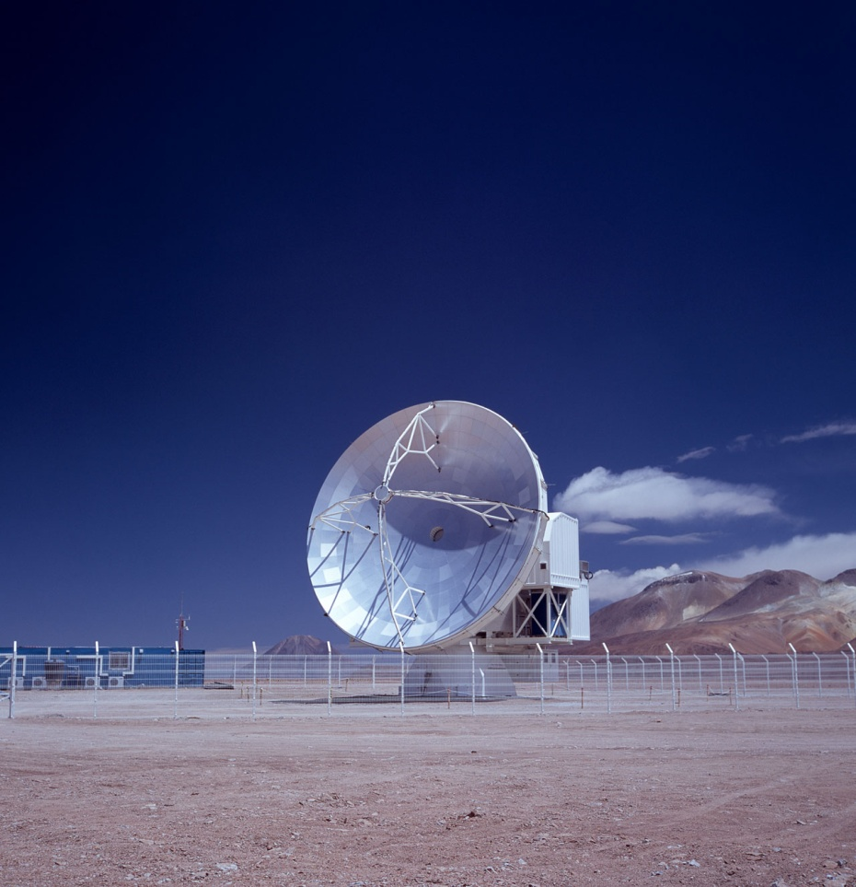
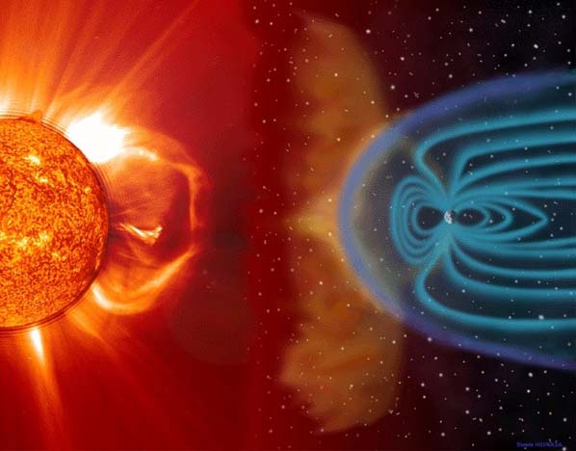
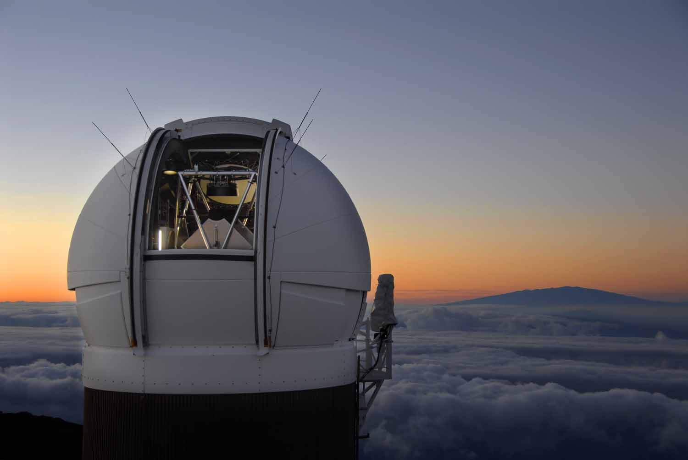
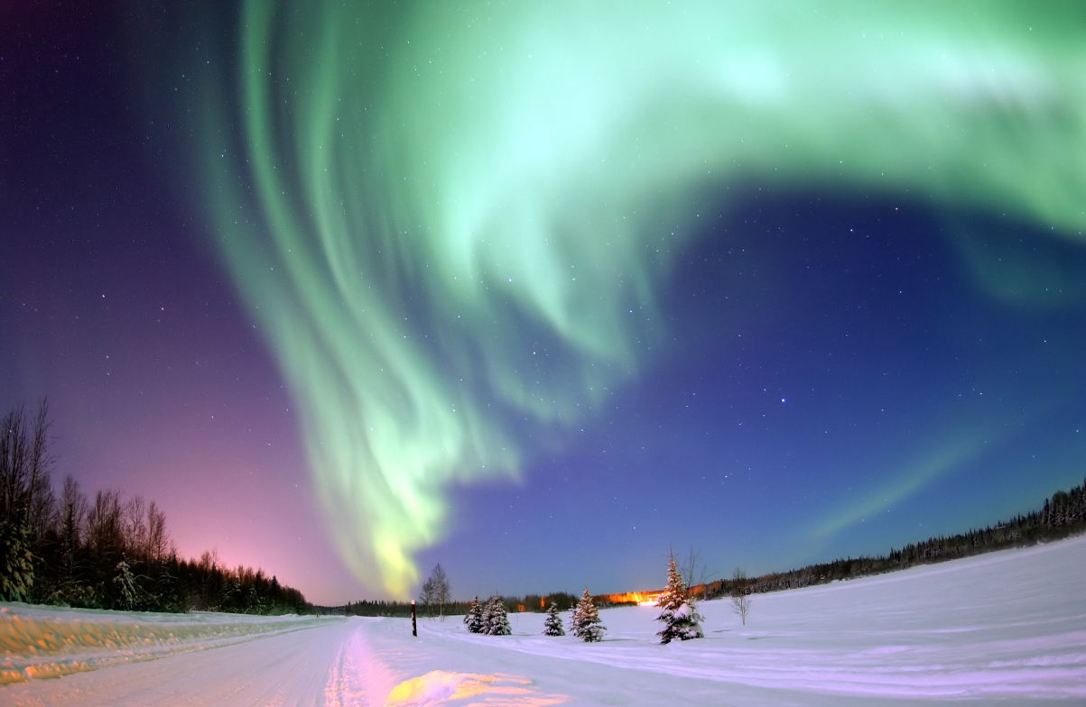
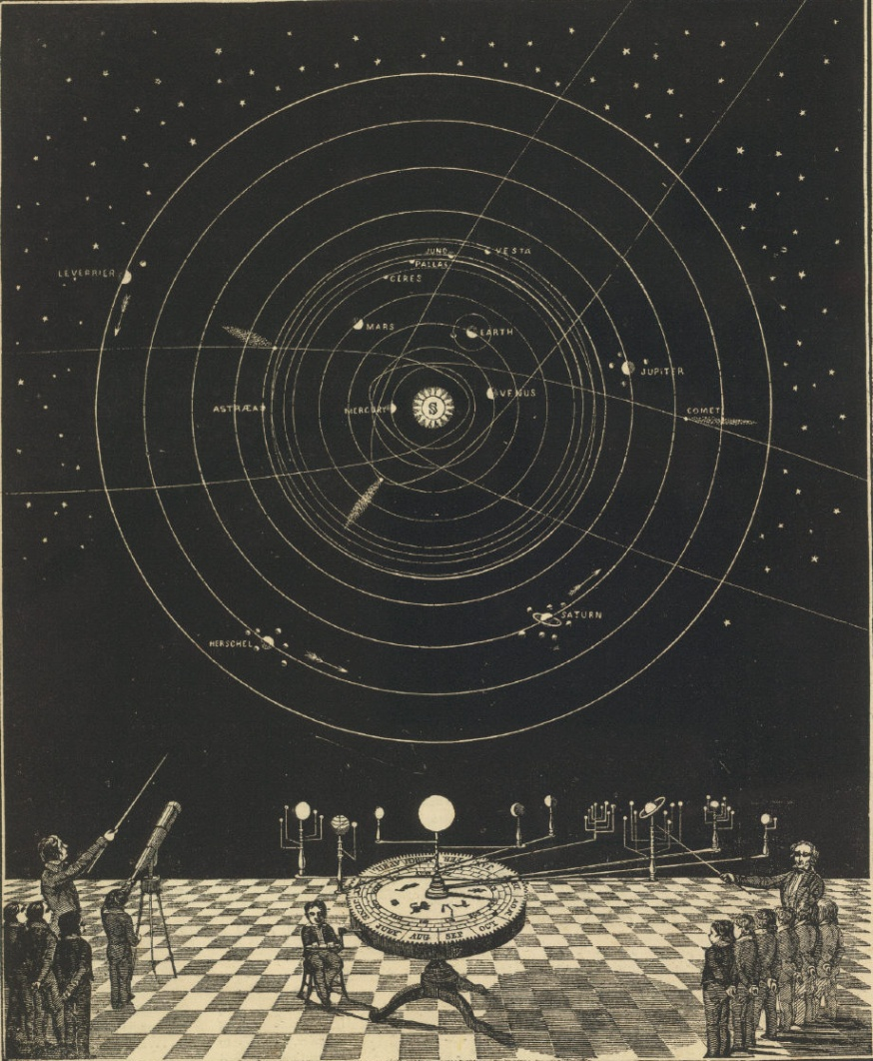
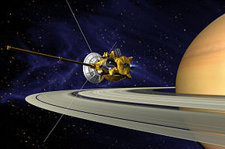
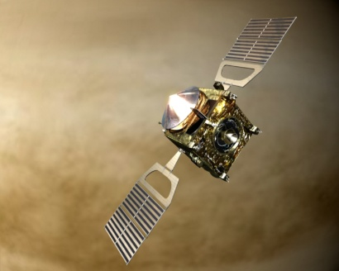
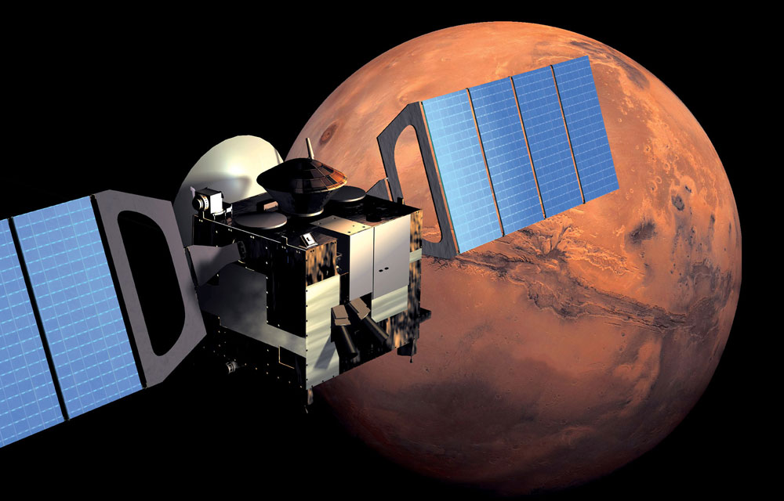
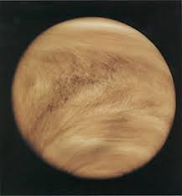
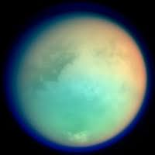
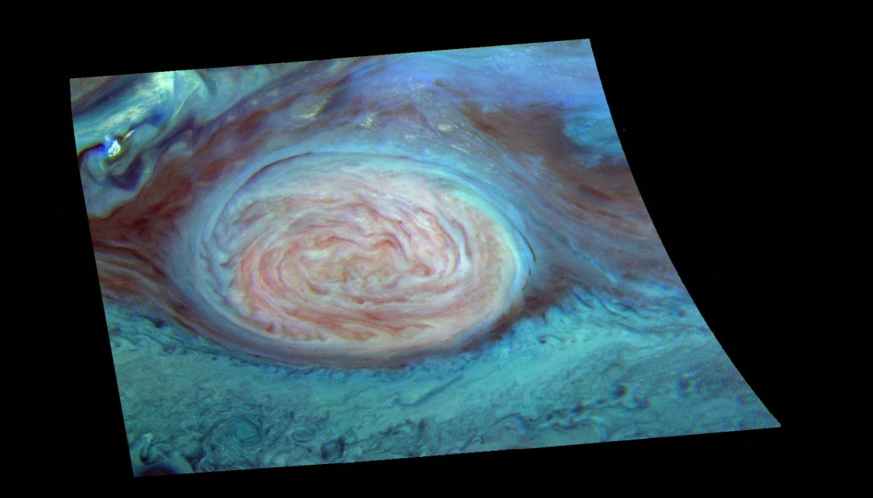
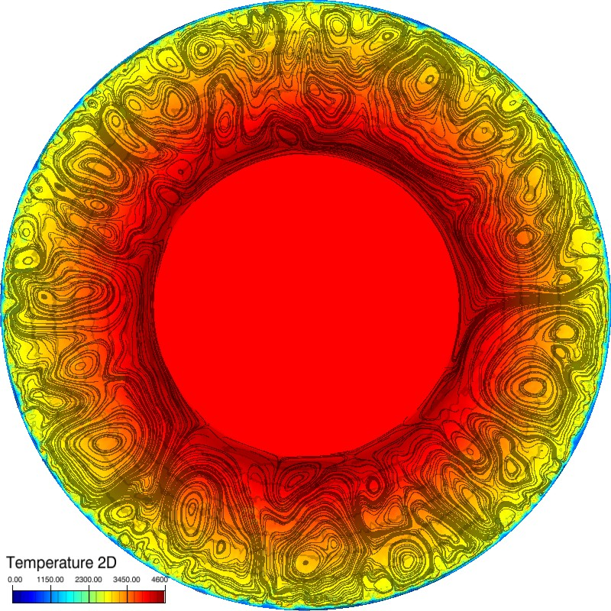
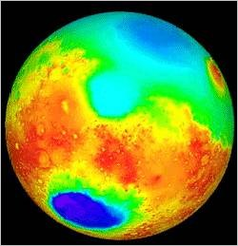
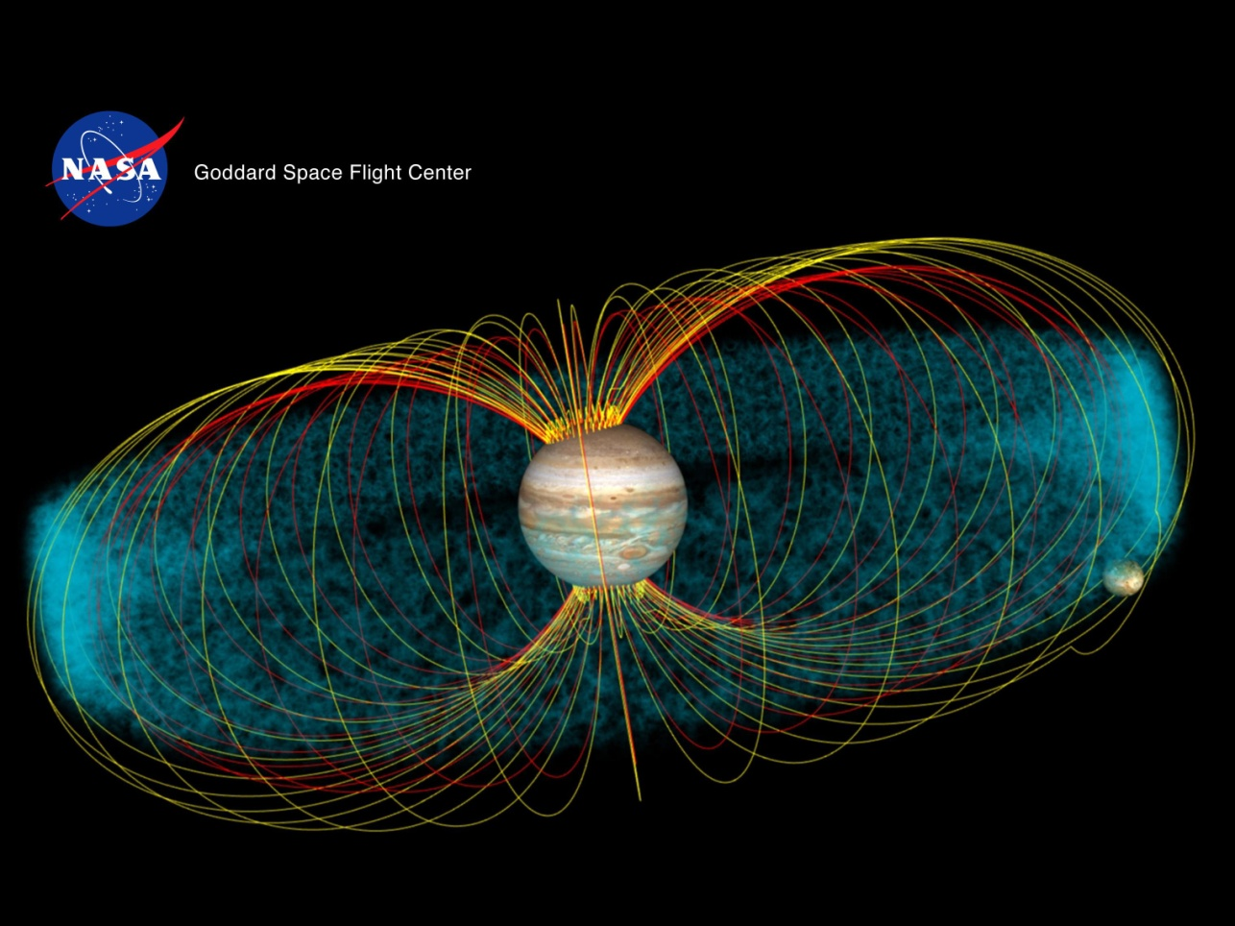
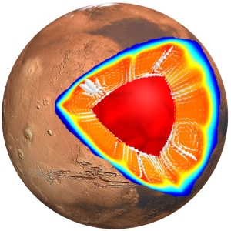
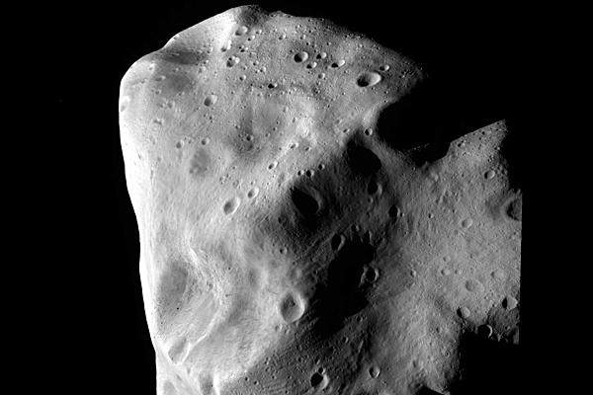
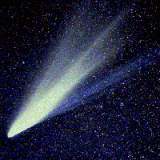
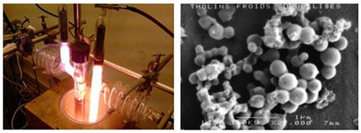
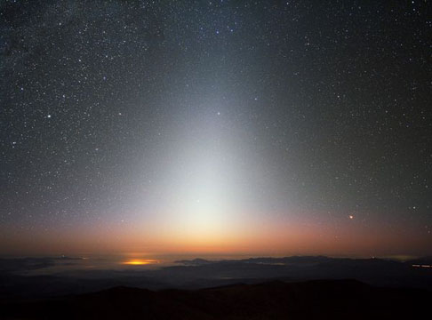
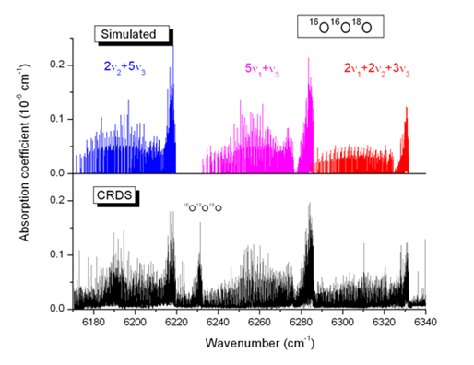
Data in Planetary Science
FIELDS
TYPES
ORIGINS
Image
Spectrum
Dynamic spectrum
Spectral cube
Volume
Profile
Movie
Cube
Time series
Catalog
Spatial vector
Earth based observations
Artist view, Terrestrial magnetosphere. ESA.
Hubble Telescope. ESA.
APEX Telescope. ES0.
Experiments
Plasmas
Spectroscopy
Remote sensing
Pan-STARRS telescope on Maui. NASA
Aurora borealis. NASA.
Absorption/
Reflectance/Emission
Space observations
Imaging
Solar System Orrery by Asa Smith, 1850
Magnetic field
Dust spectroscopy
Planetary dynamics and extra-terrestrial matter
Particle spectroscopy (mass, energy, electric charge, velocity…)
Chromatography
CASSINI. NASA
Venus Express. ESA.
Altimetry
Gravity field
Venus Atmosphere. NASA/NSSDC
Titan Atmosphere. NASA
Reference frames
Mars Express. ESA.
Atmospheres
Numerical simulations
Planet reference frame
Heliocentric reference frame
Earth reference frame
Jupiter’s red spot. NASA
Interiors and surfaces
Coordinate systems
Mars. NASA.
Venus. DLR.
Cartesian
Spherical
2D, 3D
Jupiter. NASA.
Mars. German Aerospace Centre (DLR).
Laboratory experiments
Asteroid Lutetia. ESA.
Small bodies, dust and TNO’s
Timescales
~1s to ~1h
Diurnal
Seasonal
Secular
PLASMA experiment. LISA/IPSL
Comet West. OHP, FRANCE.
Zodiacal light, Chile. ESO.
LIPhy

